Slide 1


Slide 2
Dealing with Anger in a God-honoring Way

Slide 3
Aspect 1: Deal with problems on a regular, daily basis

Slide 4
Eph 4:26
“Be angry and do not sin; do not let the sun go down on your anger,”
(Eph 4:26 ESV)

Slide 5
Deal with problems regularly
Option 1: Overlook the conflict in love.

Slide 6
Overlook the conflict
“Above all, keep loving one another earnestly, since love covers a multitude of sins.”
(1 Pet 4:8 ESV)

Slide 7
Overlook the sin
“Hatred stirs up strife,
But love covers all offenses.”
(Prov 10:12 ESV)

Slide 8
Overlook the sin
“Good sense makes one slow to anger,
And it is his glory to overlook an offense.”
(Prov 19:11 ESV)

Slide 9
Practical Considerations
Ask yourself—is this sin?
Ask yourself—is this really that big of a deal?

Slide 10
Deal with problems regularly
Option 1: Overlook the conflict in love.
Option 2: Resolve the problem

Slide 11
“Go privately to that person for the purpose of resolving the problem. The purpose of that meeting should be only for promoting reconciliation and unity, not for criticizing or condemning.”

Slide 12
Is it creating an unreconciled relationship?
Matt. 5:23 (ESV) So if you are offering your gift at the altar and there remember that your brother has something against you, 24 leave your gift there before the altar and go. First be reconciled to your brother, and then come and offer your gift.

Slide 13
Is it creating an unreconciled relationship?
Phil. 2:1 (ESV) So if there is any encouragement in Christ, any comfort from love, any participation in the Spirit, any affection and sympathy, 2 complete my joy by being of the same mind, having the same love, being in full accord and of one mind. 3 Do nothing from selfish ambition or conceit, but in humility count others more significant than yourselves. 4 Let each of you look not only to his own interests, but also to the interests of others.

Slide 14
Is it possible this person might not be growing and needs confrontation?
Heb. 3:12 (ESV) Take care, brothers, lest there be in any of you an evil, unbelieving heart, leading you to fall away from the living God. 13 But exhort one another every day, as long as it is called “today,” that none of you may be hardened by the deceitfulness of sin. 14 For we have come to share in Christ, if indeed we hold our original confidence firm to the end.

Slide 15
Is it possible this person might not be growing and needs confrontation?
James 5:19 (ESV) My brothers, if anyone among you wanders from the truth and someone brings him back, 20 let him know that whoever brings back a sinner from his wandering will save his soul from death and will cover a multitude of sins.

Slide 16
Is it possible this person might not be growing and needs confrontation?
2Pet. 1:5 (ESV) For this very reason, make every effort to supplement your faith with virtue, and virtue with knowledge, 6 and knowledge with self-control, and self-control with steadfastness, and steadfastness with godliness, 7 and godliness with brotherly affection, and brotherly affection with love. 8 For if these qualities are yours and are increasing, they keep you from being ineffective or unfruitful in the knowledge of our Lord Jesus Christ. 9 For whoever lacks these qualities is so nearsighted that he is blind, having forgotten that he was cleansed from his former sins. 10 Therefore, brothers, be all the more diligent to confirm your calling and election, for if you practice these qualities you will never fall.

Slide 17
Will there be dangerous consequences?
Matt. 18:6 (ESV) but whoever causes one of these little ones who believe in me to sin, it would be better for him to have a great millstone fastened around his neck and to be drowned in the depth of the sea.
1Cor. 5:6 (ESV) Your boasting is not good. Do you not know that a little leaven leavens the whole lump? 7 Cleanse out the old leaven that you may be a new lump, as you really are unleavened. For Christ, our Passover lamb, has been sacrificed.
1Cor. 12:26 (ESV) If one member suffers, all suffer together; if one member is honored, all rejoice together.

Slide 18
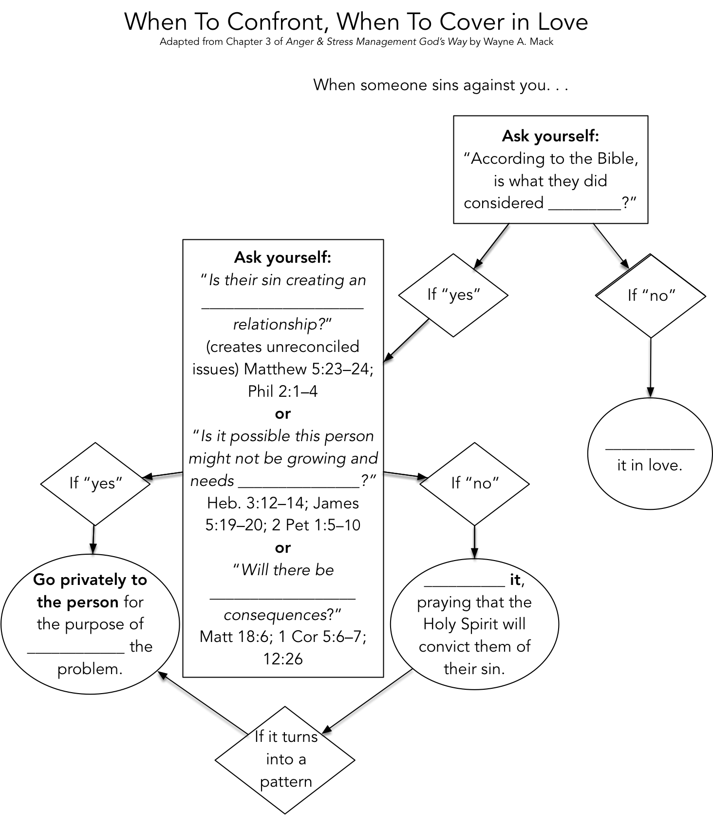

Slide 19


Slide 20
Aspect 2: Understand that you can control and restrain the expression of your anger.

Slide 21
Control and restrain anger
“A fool gives full vent to his spirit,
But a wise man quietly holds it back.”
(Prov 29:11 ESV)
“Whoever is slow to anger is better than the mighty,
And he who rules his spirit than he who takes a city.”
(Prov 16:32 ESV)

Slide 22
The fact is, we do this all the time. When we fail to control our anger, it’s because we don’t consider the stakes to be high enough.

Slide 23
Control and restrain anger
“for the anger of man does not produce the righteousness of God.”
(James 1:20 ESV)
“Be not quick in your spirit to become angry,
For anger lodges in the heart of fools.”
(Eccl 7:9 ESV)

Slide 24
Restrain and Control
Recognize the fact that as Christians indwelt by the Holy Spirit we do have the power to control our anger.
  Desire to obey God by controlling your anger (never excuse, justify, or rationalize anger).
  Prepare yourself to acknowledge and deal with it honestly.

Slide 25
Aspect 3: Take time to examine the reasons for your anger.

Slide 26
Examine Your Anger
Do you get angry because some of your “rights” are being denied?
Are you angry because you love God, His truth, and His righteousness?
Many times, our anger comes because we want our own way (to control people or the situation and we are unable to do this).

Slide 27
What Causes Strife?
“What causes quarrels and what causes fights among you? Is it not this, that your passions are at war within you? You desire and do not have, so you murder. You covet and cannot obtain, so you fight and quarrel. You do not have, because you do not ask. You ask and do not receive, because you ask wrongly, to spend it on your passions.”
(James 4:1–3 ESV)

Slide 28
What Causes Strife?
“By insolence comes nothing but strife,
But with those who take advice is wisdom.”
(Prov 13:10 ESV)

