Slide 1
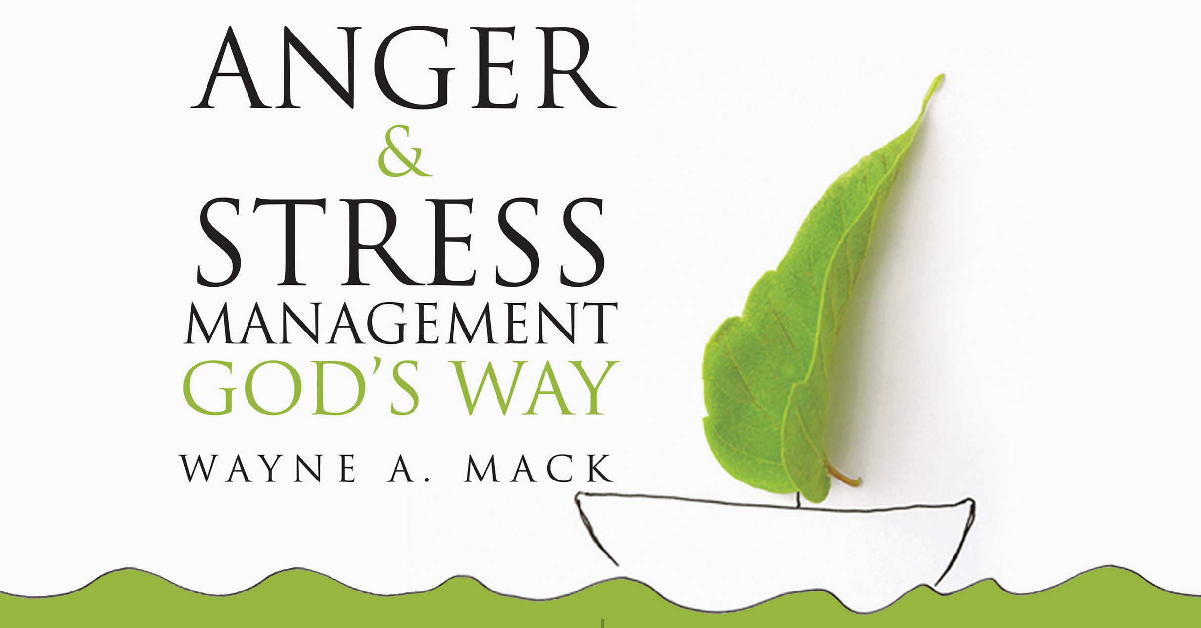

Slide 2
Sometimes it’s right and sometimes it’s wrong to be angry

Slide 3
Ephesians 4:31
“Let all bitterness and wrath and anger and clamor and slander be put away from you, along with all malice.”

Slide 4
Examples of Sinful Anger
Genesis 4
1 Samuel 18; 20:31
Mark 6:19
Acts 7:54
Acts 23:3–5

Slide 5
Examples of Anger (not sinful)
Ephesians 4:26
Psalm 7:11
Exodus 4:14
Deuteronomy 29:27–28
Mark 3:5 (remember 1 John 3:5)
John 2:13–17
Acts 17:16
2 Corinthians 7:9–11

Slide 6
Application Questions
What do you think about the idea that anger is sometimes righteous and sometimes sinful?
Which of the two types of anger do you think occurs more frequently?
Which of the two types of anger do you think you experience more frequently?

Slide 7
Characteristics of Sinful Anger
Our anger is sinful when we become angry for the wrong reasons.
What arouses our anger and makes it sinful.
What does the issue of rights have to do with sinful anger?
Our anger is sinful when we allow our anger to control us. (Proverbs 16:32)
Our anger is sinful when it becomes the dominant feature of our lives. (Proverbs 19:19; 22:24)

Slide 8
When is anger wrong?
Our anger is sinful when it involves brooding or fretting. (Psalm 37; Eph 4:26–27; Prov 30:33)
Our anger is sinful when we keep a running record of how we have been mistreated. (1 Cor 13:5; Lev 19:18; Col 3:19)
Our anger is sinful when we pretend that we are not angry. (Eph 4:25; James 5:16; 2 Cor 9:8)
Our anger is sinful when we return evil for evil or attack the person with whom we are angry. (Prov 29:11; 29:22)
Some people express anger verbally.
Some express anger passively.
Some express anger physically.
Our anger is sinful when we attack or hurt a substitute. (1 Samuel 20)

